Slide 1
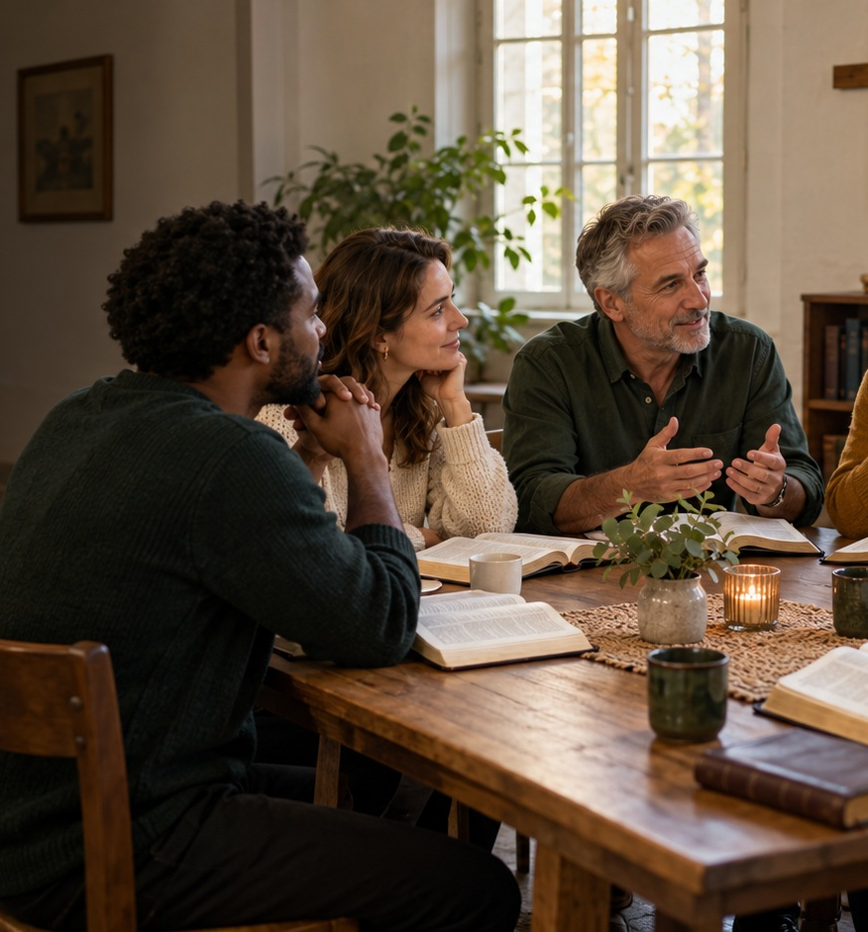
Where Christians
Disagree
20 major questions of faith explored
Gerard Feller
fellerbooks.com
01
Notes:
Based on Gerard Feller, Waar christenen van mening verschillen [Where Christians Disagree], supplied Feller Books edition. Title and author: PDF file page 2. This presentation summarises the twenty chapters. The photograph is an illustrative AI-generated scene, not a record of an actual gathering.
This slide provides a concise summary of the content. Images are illustrative and do not constitute evidence for a doctrine.

Slide 2
The same Bible, different conclusions
Sincere Christians can read the same Scriptures and reach different conclusions.
Purpose
Attitude
To understand other people’s arguments and examine our own convictions carefully.
To seek truth with respect for the person.
fellerbooks.com
02
Notes:
The foreword does not seek to win twenty arguments. The author adopts a classical evangelical perspective: Scripture as the decisive standard and salvation by God’s grace in Jesus Christ. Understanding does not automatically mean agreement.
Source: Gerard Feller, Waar christenen van mening verschillen [Where Christians Disagree], supplied Feller Books edition, PDF file pages 6–7.
This slide provides a concise summary of the content. Images are illustrative and do not constitute evidence for a doctrine.

Slide 3
Six traditions in conversation
Evangelical
Reformed
Personal faith in Christ and the authority of Scripture.
Grace, covenant and confessions of faith.
Roman Catholic
Eastern Orthodox
Scripture and apostolic Tradition, with the Church’s teaching authority.
Holy Tradition, liturgy and life in Christ.
Baptist
Pentecostal and charismatic
Believer’s baptism and the responsibility of the local congregation.
The present work and gifts of the Holy Spirit.
These descriptions overlap. Differences exist within every tradition.
03
Notes:
These six traditions form the book’s comparative framework. They are not six closed or mutually exclusive categories. A Baptist can also be evangelical and charismatic. Present the descriptions as emphases, not complete definitions.
Source: Gerard Feller, Waar christenen van mening verschillen [Where Christians Disagree], supplied Feller Books edition, PDF file pages 6–7, 22.
This slide provides a concise summary of the content. Images are illustrative and do not constitute evidence for a doctrine.

Slide 4
Where differences begin
Authority
How we read
Who determines which interpretation carries authority?
How do context, genre and tradition shape interpretation?
Connections
Application
How do we connect the Old and New Testaments?
Which commands remain binding, and how do they apply today?
fellerbooks.com
04
Notes:
The concluding reflection shows that disagreements often begin before the final conclusion. They concern the assumptions through which a text is read. A dictionary definition is not yet a complete interpretation of a passage.
Source: Gerard Feller, Waar christenen van mening verschillen [Where Christians Disagree], supplied Feller Books edition, PDF file pages 7, 159–160.
This slide provides a concise summary of the content. Images are illustrative and do not constitute evidence for a doctrine.

Slide 5
A history of different emphases
325–451
Early councils
Confessions about God and Christ
1054
East and West
Traditional marker of the division
16th century
Reformation and Trent
Authority, grace and sacraments
17th–18th centuries
Dort and revivals
Election, conversion and holiness
20th century
Pentecostal and charismatic
Renewed attention to spiritual gifts
fellerbooks.com
05
Notes:
A selection from the book’s historical timeline. The division between East and West was a long process, for which 1054 serves as a traditional marker. Each period contains more developments than this overview can show.
Source: Gerard Feller, Waar christenen van mening verschillen [Where Christians Disagree], supplied Feller Books edition, PDF file pages 156–157.
This slide provides a concise summary of the content. Images are illustrative and do not constitute evidence for a doctrine.

Slide 6
PART I
Authority, salvation
and grace
Questions 1–5
fellerbooks.com
06
Notes:
Part I of the book: PDF file page 16 and Chapters 1–5. These questions are connected: an understanding of authority influences interpretations of salvation, election, assurance and baptism.
This slide provides a concise summary of the content. Images are illustrative and do not constitute evidence for a doctrine.

Slide 7
1 Who has the final word?
Protestant emphasis
Roman Catholic
Eastern Orthodox
Scripture has decisive authority. Tradition and confessions remain open to examination.
Scripture and apostolic Tradition form one deposit of faith. The Magisterium interprets it authoritatively.
The Church reads Scripture within Holy Tradition, with councils, Church Fathers and liturgy.
2 Timothy 3:16–17
fellerbooks.com
07
Notes:
The book does not treat Sola Scriptura as a rejection of all historical interpretation. Roman Catholic and Orthodox positions are not identical either: papal teaching authority has a different place in the two traditions. Ask which authority can ultimately correct an interpretation.
Source: Gerard Feller, Waar christenen van mening verschillen [Where Christians Disagree], supplied Feller Books edition, PDF file pages 17–23.
This slide provides a concise summary of the content. Images are illustrative and do not constitute evidence for a doctrine.

Slide 8
2 How is a person saved?
Protestant emphases
Roman Catholic
Eastern Orthodox
Justification through faith. Good works follow as the fruit of grace.
Grace forgives and renews. Faith and sacramental life belong together.
Salvation as healing and participation in God’s life through grace.
Ephesians 2:8–10, Romans 3, James 2
fellerbooks.com
08
Notes:
Avoid the caricature that Protestants teach grace and Catholics teach self-salvation. According to the book, God’s grace comes first in the major traditions. Theosis means participation through grace, not that a person becomes God in essence. Paul and James challenge different misunderstandings concerning works and faith.
Source: Gerard Feller, Waar christenen van mening verschillen [Where Christians Disagree], supplied Feller Books edition, PDF file pages 24–29.
This slide provides a concise summary of the content. Images are illustrative and do not constitute evidence for a doctrine.

Slide 9
3 Does God choose, or do we choose?
Reformed
Arminian
God’s unconditional election and effective calling sustain salvation.
God’s preceding grace makes a genuine human response possible. Grace can be resisted.
Both models begin with God’s grace and confess Christ as the basis of salvation.
Ephesians 1, John 6, Romans 9–11
fellerbooks.com
09
Notes:
Arminianism is not Pelagianism. Both models reject self-salvation. They differ over how God’s initiative and the human response relate. Romans 9 must be read within Romans 9–11, including Israel and the nations.
Source: Gerard Feller, Waar christenen van mening verschillen [Where Christians Disagree], supplied Feller Books edition, PDF file pages 30–34.
This slide provides a concise summary of the content. Images are illustrative and do not constitute evidence for a doctrine.

Slide 10
4 Can you lose your salvation?
Perseverance through God’s keeping
A real possibility of falling away
Those truly born again will ultimately remain in faith through God’s grace.
Warnings address genuine believers and call them to remain in Christ.
The New Testament places promises of assurance alongside serious warnings.
John 10, Romans 8, Hebrews 6 and 10
fellerbooks.com
10
Notes:
The classical Reformed doctrine is not simply that once someone has prayed a prayer, the rest of life no longer matters. Other traditions understand the warnings as a real possibility of falling away. Pastoral balance avoids both constant fear and complacency.
Source: Gerard Feller, Waar christenen van mening verschillen [Where Christians Disagree], supplied Feller Books edition, PDF file pages 35–38.
This slide provides a concise summary of the content. Images are illustrative and do not constitute evidence for a doctrine.

Slide 11
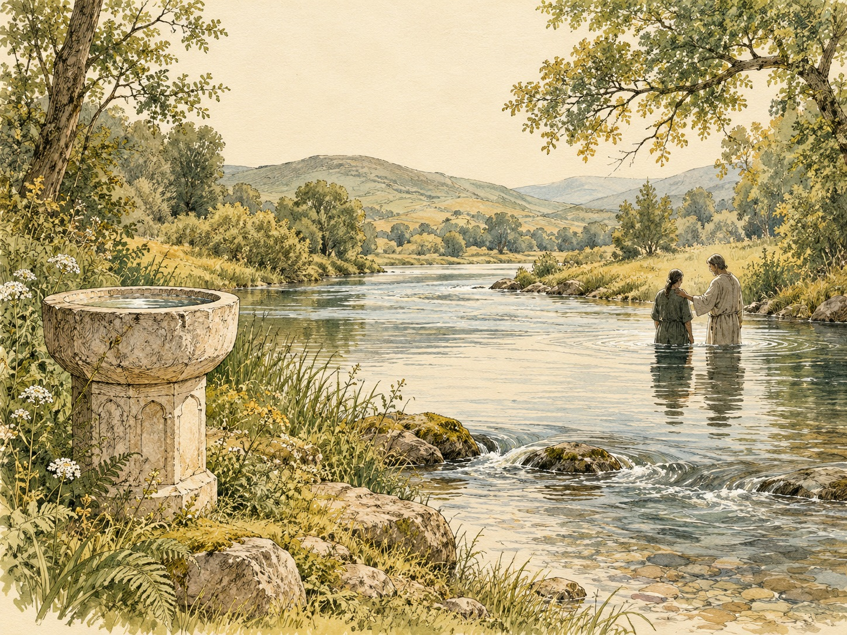
5 Who should be baptised?
Infant baptism
God’s covenant and his preceding grace include children.
Believer’s baptism
Baptism follows a personal profession of faith and discipleship.
The deeper question concerns covenant, congregation and personal faith.
Acts 2, Romans 6, Colossians 2
fellerbooks.com
11
Notes:
Arguments for infant baptism differ between Reformed, Catholic and Orthodox traditions. Reformed infant baptism does not automatically guarantee personal salvation. Household baptism texts do not explicitly mention babies being present. The amount of water is a separate issue too. Image: conceptual AI-generated drawing, not a historical event.
Source: Gerard Feller, Waar christenen van mening verschillen [Where Christians Disagree], supplied Feller Books edition, PDF file pages 39–45.
This slide provides a concise summary of the content. Images are illustrative and do not constitute evidence for a doctrine.

Slide 12
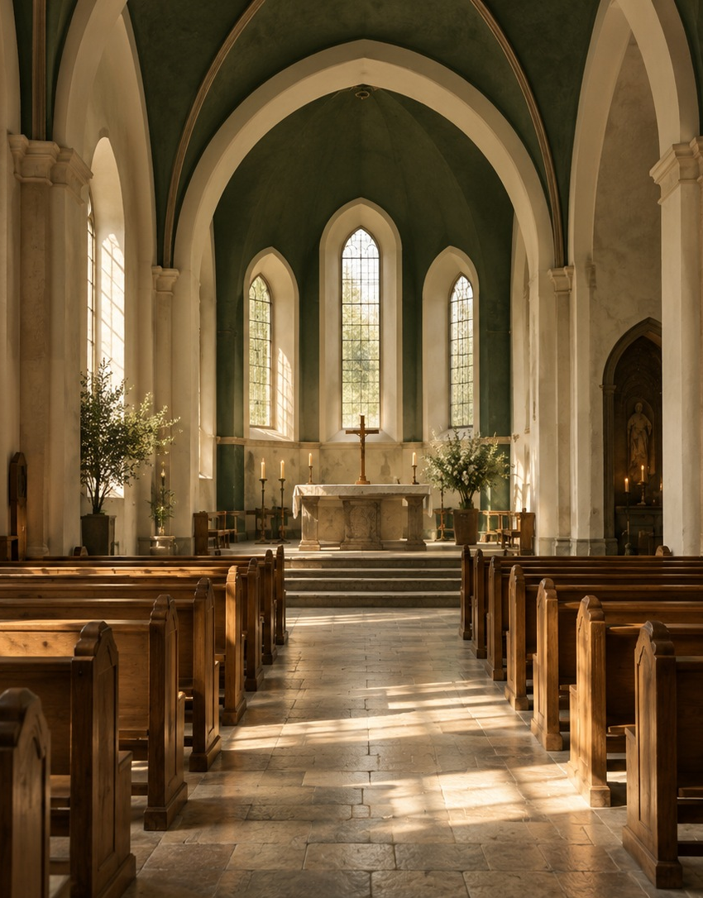
PART II
Church, sacrament
and Holy Spirit
Questions 6–10
fellerbooks.com
12
Notes:
Part II, PDF file page 47 and Chapters 6–10. Understandings of church and ministry connect with sacraments, guidance and spiritual gifts. Image: AI-generated photographic illustration of an unidentified church interior.
This slide provides a concise summary of the content. Images are illustrative and do not constitute evidence for a doctrine.

Slide 13
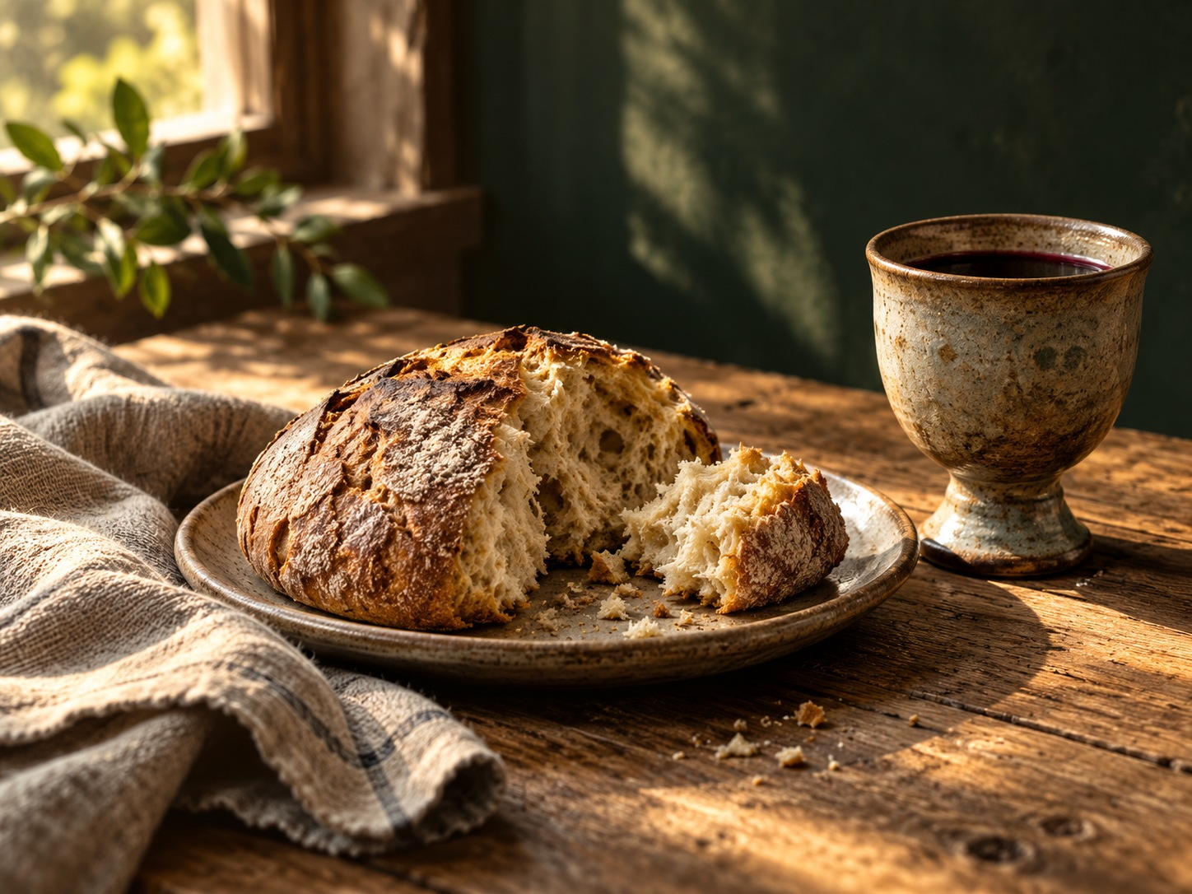
6 What happens at the Lord’s Supper?
Remembrance and proclamation
Bread and wine point to Christ and unite the congregation.
Real presence
Reformed, Catholic and Orthodox traditions understand this presence differently.
Different understandings of the Lord’s Supper arose within the Reformation itself.
Luke 22, 1 Corinthians 10–11
fellerbooks.com
13
Notes:
Zwingli emphasises remembrance and sign. Calvin speaks of real spiritual communion with Christ. Luther defends another form of real presence. Roman Catholic transubstantiation and Orthodox language of mystery should not simply be merged. Image: illustrative AI-generated still-life photograph.
Source: Gerard Feller, Waar christenen van mening verschillen [Where Christians Disagree], supplied Feller Books edition, PDF file pages 48–53.
This slide provides a concise summary of the content. Images are illustrative and do not constitute evidence for a doctrine.

Slide 14
7 What is the true Church?
Historical continuity
Apostolic proclamation
Local congregation
Catholic and Orthodox traditions emphasise bishops, sacraments and apostolic succession.
Protestant traditions look to Word, sacrament and faithfulness to the gospel.
Baptist traditions give substantial responsibility to the congregation of professing believers.
Christ is the Head of the Church.
Matthew 16, Ephesians 1 and 4
fellerbooks.com
14
Notes:
Catholic and Orthodox understandings of the Church differ, among other things, over universal papal jurisdiction. Protestant structures vary. Apostolicity may refer both to historical continuity in ministry and to faithfulness to apostolic teaching. The source also discusses the visible and invisible Church.
Source: Gerard Feller, Waar christenen van mening verschillen [Where Christians Disagree], supplied Feller Books edition, PDF file pages 54–59.
This slide provides a concise summary of the content. Images are illustrative and do not constitute evidence for a doctrine.

Slide 15
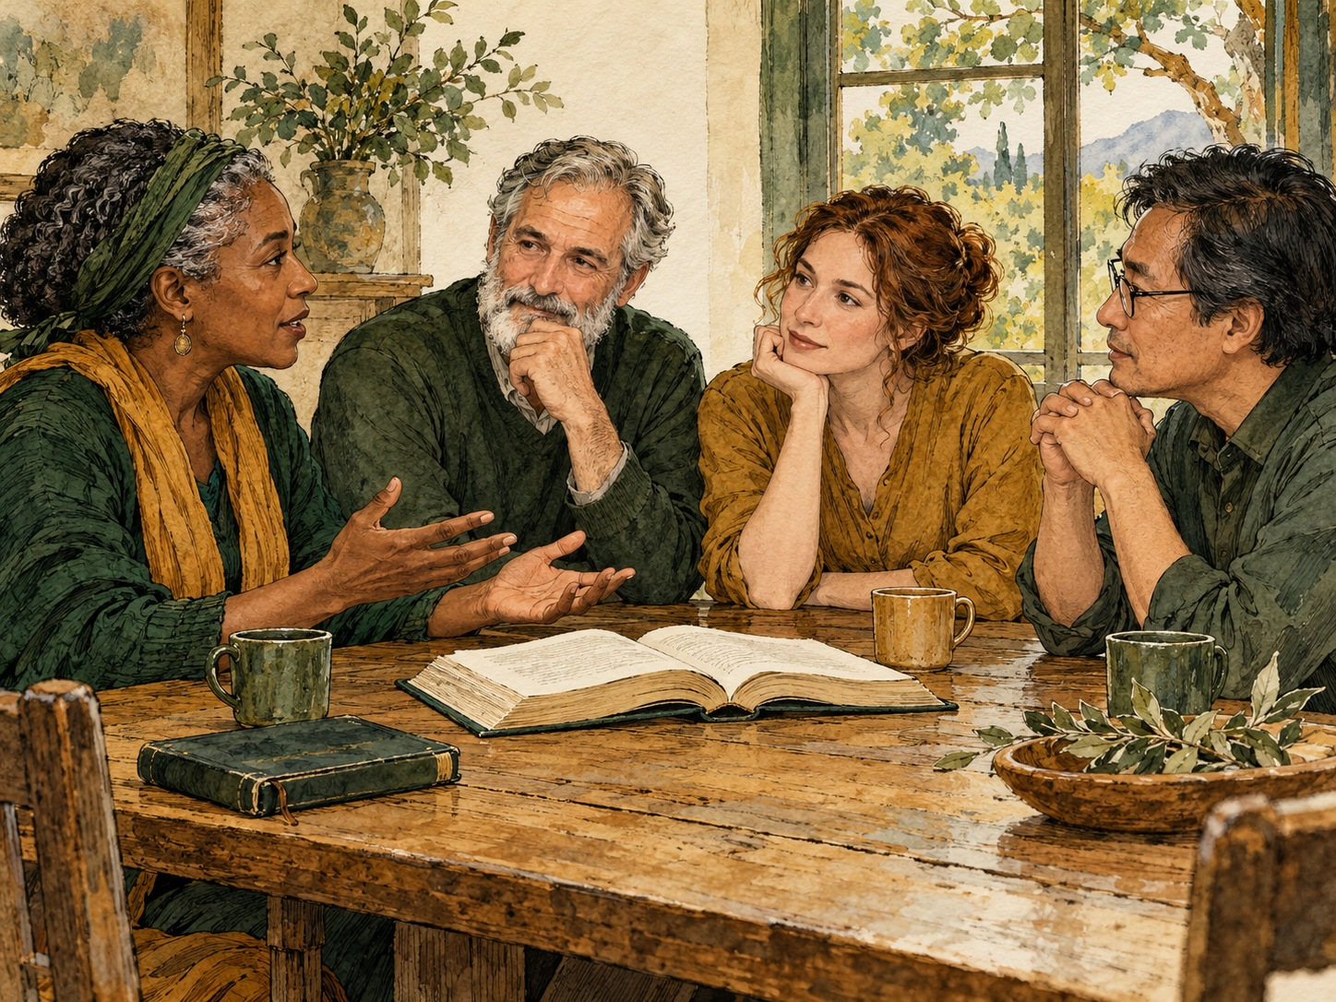
8 Who may lead?
Complementarian
Equal dignity, with distinctions in certain church offices.
Egalitarian
Men and women can hold the same offices on the basis of calling and gifts.
The discussion requires interpreting church office, context and related biblical passages.
1 Timothy 2, Romans 16, Acts 18
fellerbooks.com
15
Notes:
Both positions appeal to Scripture. Discuss the passages about Priscilla, Phoebe and Junia alongside 1 Timothy 2. An active ministry does not always establish which formal office someone held. Denominations also differ over the meaning of priest, elder, pastor and apostle. Image: conceptual AI-generated drawing about listening and discussion, not a statement about eligibility for church office.
Source: Gerard Feller, Waar christenen van mening verschillen [Where Christians Disagree], supplied Feller Books edition, PDF file pages 60–66.
This slide provides a concise summary of the content. Images are illustrative and do not constitute evidence for a doctrine.

Slide 16
9 Does God still speak directly today?
Christians differ over present-day prophecy and special guidance.
A cautious approach
A continuationist approach
The emphasis lies on God speaking through Scripture and unique apostolic revelation.
The Spirit may give special guidance. Every impression requires testing.
Appealing to “God said…” must not put anyone beyond accountability.
1 Thessalonians 5:19–22, 1 Corinthians 14
fellerbooks.com
16
Notes:
The book identifies Scripture, the character of Christ, fruit, wisdom, mature believers and facts as criteria for discernment. A confident prophetic statement about marriage, money, medical decisions or obedience may create enormous pressure. “I have an impression; would you test it?” acknowledges human fallibility.
Source: Gerard Feller, Waar christenen van mening verschillen [Where Christians Disagree], supplied Feller Books edition, PDF file pages 67–72.
This slide provides a concise summary of the content. Images are illustrative and do not constitute evidence for a doctrine.

Slide 17
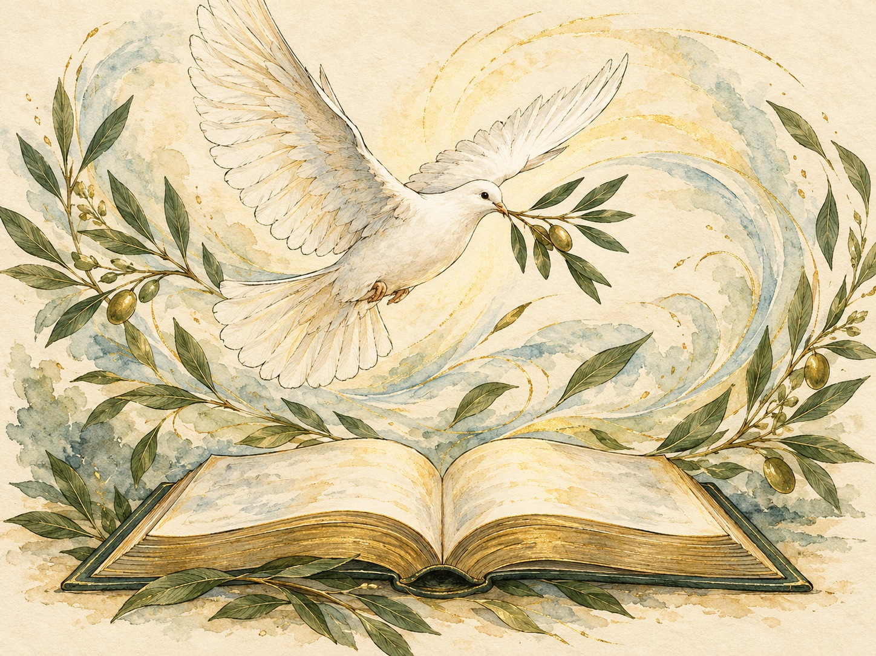
10 Are miraculous gifts for today?
Cessationism
Certain sign gifts served primarily a foundational apostolic purpose.
Continuationism
The Spirit may continue giving these gifts until Christ returns.
Gifts build up the Church. Love and discernment remain essential.
1 Corinthians 12–14
fellerbooks.com
17
Notes:
Cessationism does not necessarily mean that God cannot perform a miracle today. Continuationism does not mean that every miracle claim is true. The book distinguishes tongues in different New Testament settings and emphasises intelligibility, order and love. Image: symbolic AI-generated drawing of a dove and an open book.
Source: Gerard Feller, Waar christenen van mening verschillen [Where Christians Disagree], supplied Feller Books edition, PDF file pages 73–83.
This slide provides a concise summary of the content. Images are illustrative and do not constitute evidence for a doctrine.

Slide 18

PART III
Healing, Israel
and Christian hope
Questions 11–15
fellerbooks.com
18
Notes:
Part III, PDF file page 84 and Chapters 11–15. Hope extends beyond temporary healing, political expectations or an end-times scheme. It includes resurrection, judgement and new creation. Image: illustrative AI-generated landscape photograph as a motif of hope, not a depiction of heaven.
This slide provides a concise summary of the content. Images are illustrative and do not constitute evidence for a doctrine.

Slide 19

11 Does God still heal today?
A widely shared conviction
God can heal. Christians differ over what he has promised for this life.
Pastoral responsibility
Prayer and medical care can work together. Lack of healing does not prove a lack of faith.
The Kingdom has already come and is not yet complete.
James 5, Romans 8, 2 Corinthians 12
fellerbooks.com
19
Notes:
The book distinguishes healing, the gift of healing and a guarantee of immediate recovery. Claims of healing require careful verification. Christians still become ill and die, while bodily resurrection promises full redemption. The photograph illustrates companionship and care, not a healing event.
Source: Gerard Feller, Waar christenen van mening verschillen [Where Christians Disagree], supplied Feller Books edition, PDF file pages 85–90.
This slide provides a concise summary of the content. Images are illustrative and do not constitute evidence for a doctrine.

Slide 20
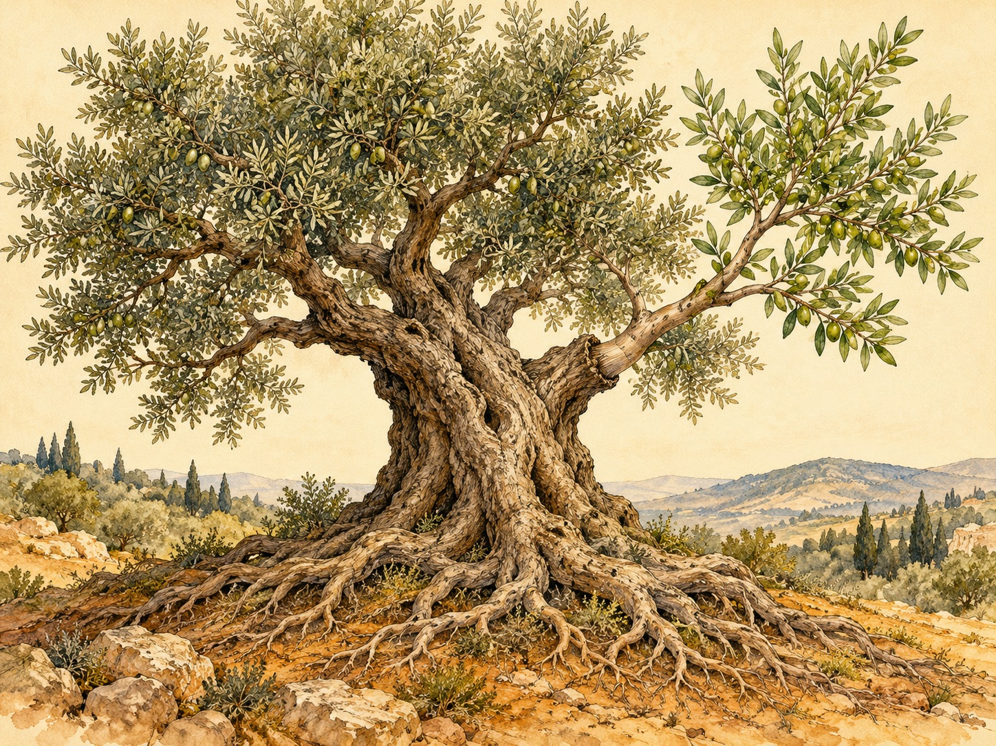
12 What place does Israel have?
Covenant theology
Strong emphasis on the unity of God’s people in Christ.
Dispensational models
A continuing distinction between Israel and the Church, with different emphases on fulfilment.
The theological question does not automatically decide every current political judgement.
Romans 9–11, Ephesians 2, Galatians 3
fellerbooks.com
20
Notes:
Progressive dispensationalism places more emphasis on coherence and present fulfilment than classical models. The book emphasises one way of salvation in Christ for Jew and Gentile. Biblical Israel and particular decisions of a modern state must not be equated without argument. Image: AI-generated drawing of an olive tree with a graft as a visual motif for Romans 11.
Source: Gerard Feller, Waar christenen van mening verschillen [Where Christians Disagree], supplied Feller Books edition, PDF file pages 91–96.
This slide provides a concise summary of the content. Images are illustrative and do not constitute evidence for a doctrine.

Slide 21
13 What happens before Christ returns?
Rapture before the tribulation
Other timings
Rapture at Christ’s coming
The Church is taken up before a future tribulation.
Midtribulationism and pre-wrath place the rapture later in the sequence.
Posttribulationist and many amillennial readings connect the meeting with Christ and his return.
The shared hope is Christ’s return and the resurrection.
1 Thessalonians 4, Matthew 24
fellerbooks.com
21
Notes:
The book discusses several sequences without definitively identifying the restrainer or a current world leader. Pre-wrath and midtribulationism are not identical models. The pastoral purpose of 1 Thessalonians 4 is to comfort one another with the promised meeting with Christ.
Source: Gerard Feller, Waar christenen van mening verschillen [Where Christians Disagree], supplied Feller Books edition, PDF file pages 97–102.
This slide provides a concise summary of the content. Images are illustrative and do not constitute evidence for a doctrine.

Slide 22
14 What is the millennium?
Premillennialism
Amillennialism
Postmillennialism
Christ returns before a future period of reigning.
The millennium symbolically describes Christ’s present or heavenly reign.
A long period of gospel influence precedes Christ’s return.
Interpretation depends partly on chronology and repetition in Revelation.
Revelation 19–20
fellerbooks.com
22
Notes:
Amillennialism does not mean that Christ has no Kingdom. The difference concerns the nature and timing of the reign. Recapitulation reads sections as a renewed perspective on the same reality. The book rejects speculative date-setting.
Source: Gerard Feller, Waar christenen van mening verschillen [Where Christians Disagree], supplied Feller Books edition, PDF file pages 103–107.
This slide provides a concise summary of the content. Images are illustrative and do not constitute evidence for a doctrine.

Slide 23
15 What happens immediately after death?
Consciously with Christ
Soul sleep
Many traditions understand the texts as teaching a conscious intermediate state before resurrection.
Other Christians emphasise human unity and await awakening at the resurrection.
The ultimate Christian expectation includes bodily resurrection and new creation.
Philippians 1, 2 Corinthians 5, 1 Corinthians 15
fellerbooks.com
23
Notes:
Biblical terms such as nephesh and psyche have a context-dependent range of meaning. The source cautions against an oversimplified picture of an unimportant body and a detached soul. Heaven, the intermediate state, resurrection and the new earth must be carefully distinguished.
Source: Gerard Feller, Waar christenen van mening verschillen [Where Christians Disagree], supplied Feller Books edition, PDF file pages 108–118.
This slide provides a concise summary of the content. Images are illustrative and do not constitute evidence for a doctrine.

Slide 24

PART IV
Judgement, Mary,
creation and life
Questions 16–20
fellerbooks.com
24
Notes:
Part IV, PDF file page 119 and Chapters 16–20. This part connects ultimate hope and judgement with scriptural authority, creation and practical discipleship. Image: conceptual AI-generated drawing of creation, not a scientific reconstruction or timeline.
This slide provides a concise summary of the content. Images are illustrative and do not constitute evidence for a doctrine.

Slide 25
16 Is hell eternal?
Eternal conscious punishment
Conditional immortality
Christian universalism
Final judgement involves permanent conscious lostness.
Judgement results in final death or destruction.
God will ultimately restore everyone. Critics point to texts about final judgement.
The book compares the arguments. The positions are not equally widely accepted.
Matthew 25, Matthew 10:28, Revelation 14 and 20
fellerbooks.com
25
Notes:
Eternal conscious punishment is the traditional majority position in many churches. The book also discusses annihilationism and universalism. Universalist “all” passages require contextual interpretation. Symbolic language in Revelation does not make judgement unreal. Speak about this seriously and without a sense of human superiority.
Source: Gerard Feller, Waar christenen van mening verschillen [Where Christians Disagree], supplied Feller Books edition, PDF file pages 120–128.
This slide provides a concise summary of the content. Images are illustrative and do not constitute evidence for a doctrine.

Slide 26
17 Does purgatory exist?
Roman Catholic
Protestant
Eastern Orthodox
Final purification of those who die in God’s grace and will be saved.
God completes sanctification without a separate doctrine of purgatory.
Prayer for the departed, without an identical adoption of the Latin doctrine of purgatory.
The difference concerns canon, justification, sanctification and tradition.
1 Corinthians 3, Hebrews 10, 2 Maccabees 12
fellerbooks.com
26
Notes:
Catholic teaching does not present purgatory as a second chance for those definitively lost. Purification, in that view, is itself grace, not a replacement for Christ’s sacrifice. Protestant interpreters read 1 Corinthians 3 as testing a person’s work. The canonical status of 2 Maccabees is a prior disagreement.
Source: Gerard Feller, Waar christenen van mening verschillen [Where Christians Disagree], supplied Feller Books edition, PDF file pages 129–133.
This slide provides a concise summary of the content. Images are illustrative and do not constitute evidence for a doctrine.

Slide 27
18 What place do Mary and the saints have?
Shared starting point
Catholic and Orthodox
The Protestant question
Mary is the mother of Jesus. Christ is the unique Mediator of salvation.
Honour and requests for the saints’ intercession belong within the communion of the Church.
Where does the New Testament authorise directly addressing departed believers?
Honour, intercession and worship require careful distinction.
Luke 1, 1 Timothy 2:5, Revelation 5 and 8
fellerbooks.com
27
Notes:
Theotokos originally defends Christ’s identity as God the Son who became human. The Immaculate Conception concerns Mary’s own conception, not the virgin birth of Jesus. Catholic and Orthodox Mariology differ on certain points. A fair comparison uses the traditions’ own definitions.
Source: Gerard Feller, Waar christenen van mening verschillen [Where Christians Disagree], supplied Feller Books edition, PDF file pages 134–139.
This slide provides a concise summary of the content. Images are illustrative and do not constitute evidence for a doctrine.

Slide 28
19 How should we read Genesis?
Young-earth creationism
Old-earth creationism
Evolutionary creation
Ordinary creation days and a relatively young earth.
An ancient cosmos and earth, allowing for distinct acts of creation.
Evolutionary processes may be means of God’s creative action.
Questions about genre, Adam and the Fall remain theologically important.
Genesis 1–3, Romans 5, 1 Corinthians 15
fellerbooks.com
28
Notes:
The source distinguishes natural science from philosophical naturalism. Accepting an old earth does not automatically imply accepting all biological evolution. A scientific model of processes does not by itself prove God’s absence. The debate about Adam requires separate treatment.
Source: Gerard Feller, Waar christenen van mening verschillen [Where Christians Disagree], supplied Feller Books edition, PDF file pages 140–146.
This slide provides a concise summary of the content. Images are illustrative and do not constitute evidence for a doctrine.

Slide 29
20 How does the Bible shape our ethics?
Christian ethics connects biblical interpretation with practical discipleship.
Norm and context
Human dignity
How do creation, commandments, Christ and the New Covenant fit together?
Ethical conviction calls for care for vulnerable people, even amid deep disagreement.
Relationships, life and death, war and peace require careful application.
Matthew 5–7, Romans 12, Galatians 5
fellerbooks.com
29
Notes:
The book discusses sexuality, divorce, the beginning and end of life, war and peace. Respect does not automatically set aside conviction, but humiliation, hatred and violence do not belong with it. Safety in situations of abuse deserves protection. Withholding disproportionate treatment is not automatically equivalent to intentionally causing death. Discuss specific cases with appropriate expertise.
Source: Gerard Feller, Waar christenen van mening verschillen [Where Christians Disagree], supplied Feller Books edition, PDF file pages 147–155.
This slide provides a concise summary of the content. Images are illustrative and do not constitute evidence for a doctrine.

Slide 30
Differences do not all carry the same weight
The centre
Major church differences
Room for diversity
God, Christ, cross and resurrection. Grace and faith. God’s ultimate victory.
Baptism, the Lord’s Supper, ministry, church structure and spiritual gifts.
Many details of end-times schemes and certain practical applications.
This framework helps discussion. Traditions may draw the boundaries differently.
fellerbooks.com
30
Notes:
This is the threefold distinction in the concluding reflection, offered as a conversation aid rather than a ranking accepted by every church. A disagreement about baptism may strongly affect congregational practice without automatically denying all Christian faith in the other person.
Source: Gerard Feller, Waar christenen van mening verschillen [Where Christians Disagree], supplied Feller Books edition, PDF file pages 159–160.
This slide provides a concise summary of the content. Images are illustrative and do not constitute evidence for a doctrine.

Slide 31
Conversation in the congregation
01
Which position from another tradition do you now understand better?
02
Which biblical passage or interpretive question is decisive for you?
03
Which conviction needs further study?
04
How can we remain faithful to our convictions and to one another?
fellerbooks.com
31
Notes:
These discussion questions are applications developed from the concluding reflection and afterword. Ask participants first to summarise the other person’s position in recognisable terms. Separate criticism of content from judgements about motives or sincerity. If helpful, choose one theme for a later meeting.
Source: Gerard Feller, Waar christenen van mening verschillen [Where Christians Disagree], supplied Feller Books edition, PDF file pages 159–165.
This slide provides a concise summary of the content. Images are illustrative and do not constitute evidence for a doctrine.

Slide 32
“Test everything.
Hold on to what is good.”
1 Thessalonians 5:21
Gerard Feller
fellerbooks.com
fellerbooks.com
32
Notes:
English rendering of the supplied edition’s motto, PDF file page 5. Conclude with the book’s emphasis: truth and love together, with Christ at the centre. Image: illustrative AI-generated landscape photograph used as a background, not a depiction of an actual future location.
This slide provides a concise summary of the content. Images are illustrative and do not constitute evidence for a doctrine.

